Slide 1
Testing Fundamentals
Black Box Testing
White Box Testing
Testing Process

Slide 2
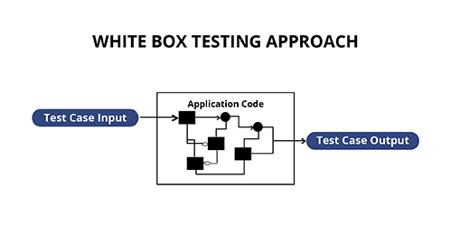

Slide 3
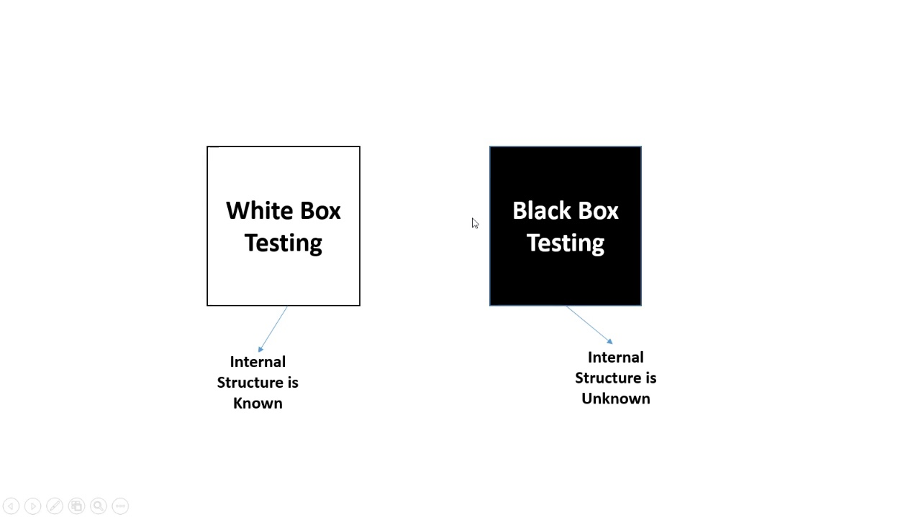

Slide 4
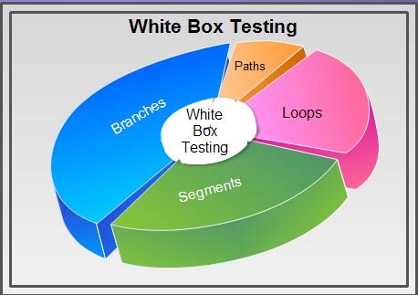

Slide 5
Testing fundamentals/ White Box Testing
Known as Clear Box Testing, Open Box Testing, Glass Box Testing, Transparent Box Testing, Code-Based Testing or Structural Testing
The internal structure/design/implementation of the item being tested is known to the tester.
Testing that is based both on expected external behavior and
knowledge of internal implementation is called "white box testing

Slide 6
White box testing is primarily used during unit testing( Components)
Unit testing is usually performed by the engineer who wrote the code
In some cases an independent tester might do unit testing

Slide 7
Complete Path Coverage
Test ALL possible paths through a subroutine.
Some paths may be impossible to achieve. Skip those paths
If there are
1. too many paths to test them all
2.especially if there are loops in the code.
If there are loops in code , we use less complete approaches:

Slide 8
Line coverage
At a minimum, every line of code should be executed by at least one test case.

Slide 9
Branch coverage
Similar to line coverage, but stronger.
Test every branch in all possible directions.
If statements
test both positive and negative directions.
Switch statements
test every branch
If no default case, test a value that doesn't match any case

Slide 10
Loop statements
test for both 0 and > 0 iterations

Slide 11
Complete Condition testing
Find the simple sub expressions that make up .
Simple pieces with no ANDs or ORs

Slide 12
Loop Testing
Design test cases based on looping structure of the routine
Testing loops
Skip loop entirely
One pass
Two passes

Slide 13
What is Verified in White Box Testing
Security holes, broken or incomplete paths, and conditional loops in a code.
Flow of structure mentioned in the specification document.
Expected outputs
Line by line or section by section in a code
Each statement, object and function is tested individually

Slide 14
Advantages / Pros of White Box Testing
Code optimization by revealing hidden errors
Transparency of the internal coding structure which is helpful in deriving the type of input data needed to test an application effectively
Covers all possible paths of a code thereby, empowering a software engineering team to conduct thorough application testing
Enables programmer to introspect because developers can carefully describe any new implementation
Test cases can be easily automated
Gives engineering-based rules to stop testing an application

Slide 15
Disadvantages / Cons of White Box Testing
A complex and expensive procedure
Defects in the code may not be detected.

Slide 16
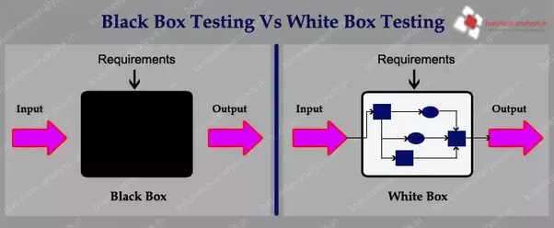

Slide 17
Black Box Testing
Black Box Testing is a testing technique where no knowledge of the internal functionality.
No structure of the system is available.
The tester only knows the formal inputs and expected outputs.
Does not know how the program actually arrives at those outputs.
Tries to find errors in the external behavior of the code.

Slide 18
Black-box is based on requirements and functionality, not code
Tester may have actually seen the code before ("gray box")
  but doesn't look at it while constructing the tests
Written without knowledge of how the class under test is implemented.
  focuses on input/output of each component or call

Slide 19
Often done from the end user or OO client's perspective
Emphasis on parameters, inputs/outputs (and their validity)

Slide 20
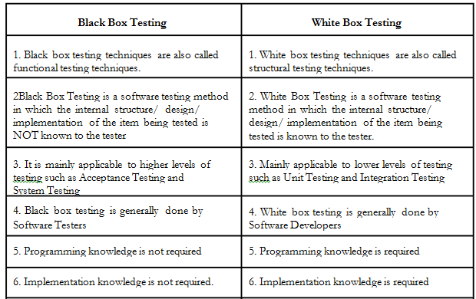
Black Box testing

Slide 21
Control structure Testing
Control structure testing is a group of white-box testing methods
  Branch Testing
Condition Testing
Data Flow Testing
Loop Testing

Slide 22
1. Condition Testing
Is a type of white box testing.
Executes logical conditions in a pgm module.
Eg: Boolean Variable, relational expression..
A Compound condition is composed of two or more simple conditions..
Eg: relational expression
E1< relational operator> E2
Where E1 & E2 etc are arithamatic expressions..
Relational operator,<,<=,=,…
Condition testing ensures testing each condition in the program to ensure that it doesnot contain errors…

Slide 23
2. Data Flow testing
Selects test path of the program according to the locations of definitions & uses of variables..
Its use should be targeted to modules with nested if and loop statements.

Slide 24
Advantages – Data flow testing
Helps to pinpoint the below issues.
A variable that is declared but never used within the program.
A variable that is used but never declared.
A variable that is defined multiple times before it is used.
Deallocating a variable before it is used.

Slide 25
3. Loop Testing
Loops are fundamental to many algorithms and need thorough testing.
4 Types
simple,
concatenated,
nested,
unstructured.

Slide 26
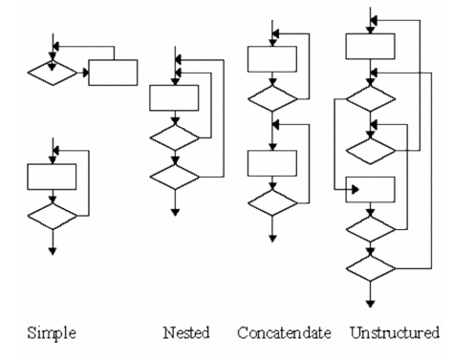
Types….

Slide 27
4.Branch Testing
called Decision Testing
For every decision, each branch needs to be executed at least once.
( 2 Branches… to be executed)
IF ( a equals b) THEN
statement 1
ELSE
statement 2
END IF

Slide 28
Eg: 4 branches to be executed)
IF ( a equals b) THEN
statement 1
ELSE
IF ( c equals d) THEN
statement 2
ELSE
statement 3
END IF
END IF

Slide 29
Project Tracking/ Gannt Chart
Illustrates a project schedule.
show the dependency relationships between activities and current schedule status.
Barchart..
Lists the tasks to be performed on the vertical axis,
and time intervals on the horizontal axis.
The width of the horizontal bars in the graph show the duration of each activity.

Slide 30
Gantt charts illustrate the start and finish dates of the terminal elements and summary elements of a project.
Terminal elements and summary elements constitute the work breakdown structure of the project.
show the dependency (i.e., precedence network) relationships between activities.

Slide 31
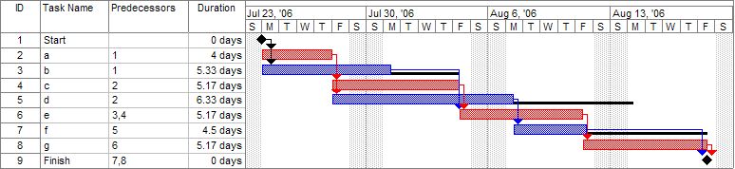

Slide 32
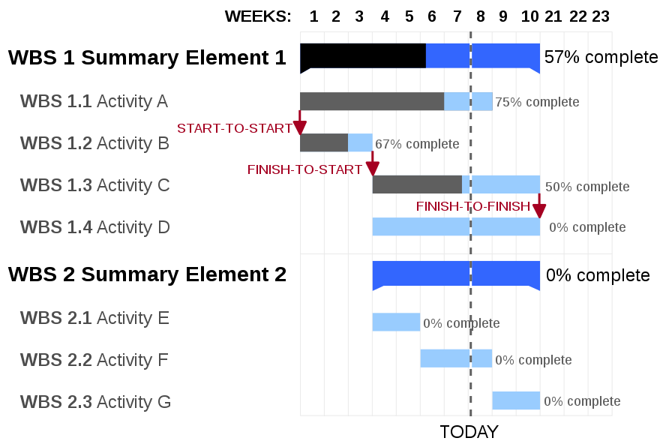

Slide 33
Work Breakdown structure
also referred to as "contract work breakdown structure“
a deliverable-oriented breakdown of a project into smaller components.
project deliverable that organizes the team's work into manageable sections.
A WBS also provides the necessary framework for detailed cost estimating and control along with providing guidance for schedule development and control.

Slide 34
WBS is a hierarchical and incremental decomposition of the project into phases &
deliverables and work packages.
is a tree structure which shows a subdivision of effort required to achieve an objective

Slide 35
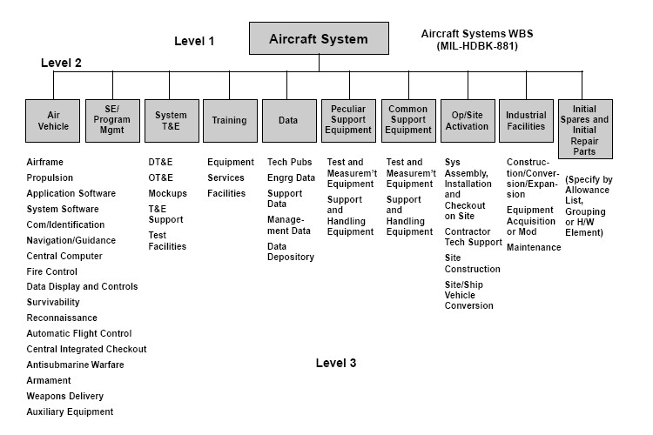

Slide 36
Program evaluation and review technique
designed to analyze and represent the tasks involved in completing a given project
especially the time needed to complete each task
event-oriented technique rather than start- and completion-oriented.
time is the major factor rather than cost.
arrows represent the activities or work necessary to reach the events or nodes that indicate each completed phase of the total project

Slide 37
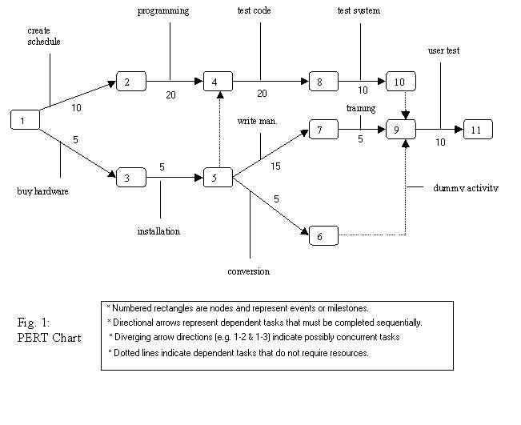

Slide 38
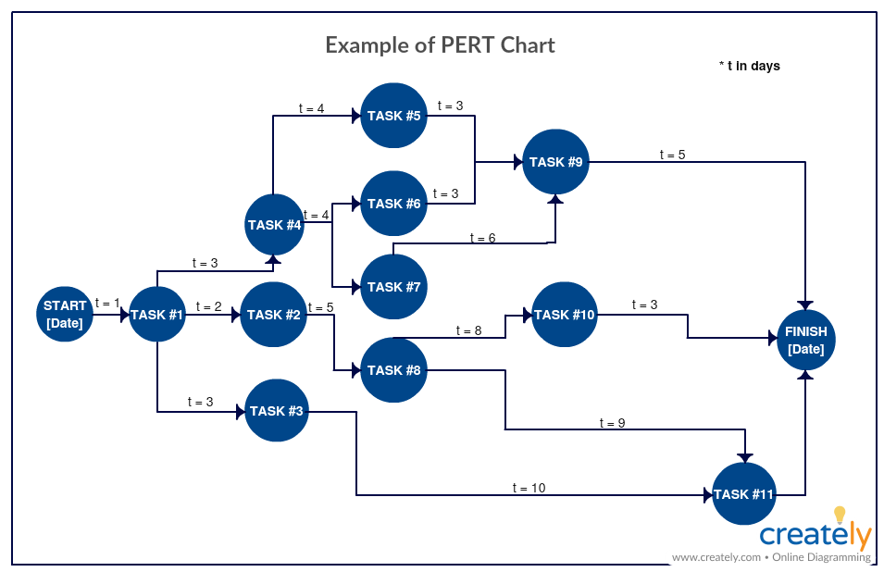

Slide 39
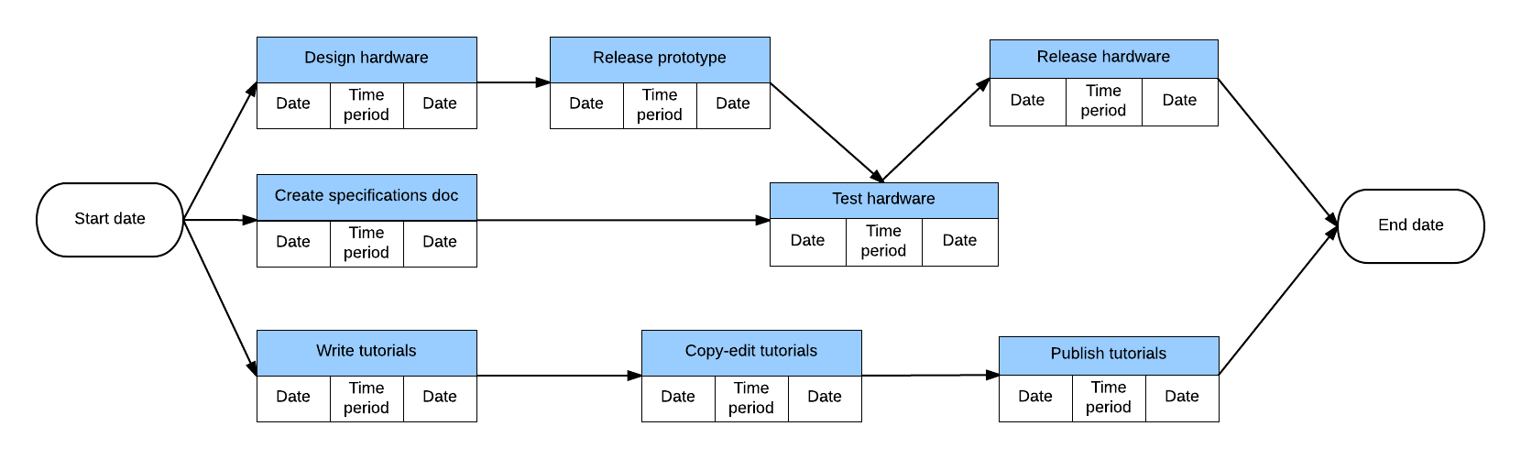

Slide 40
Unit Testing
individual units/ components of a software are tested.
The purpose is to validate that each unit of the software performs as designed
A unit is the smallest testable part of any software.
It usually has one or a few inputs and usually a single output.
In procedural programming, a unit may be an individual program, function, procedure, etc.

Slide 41
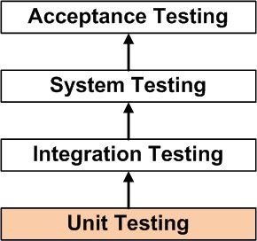

Slide 42
Unit Testing is the first level of software testing and is performed prior to Integration Testing.
Individual component (class or subsystem)
Carried out by developers
Goal:
Confirm that the component or subsystem is correctly coded and carries out the intended functionality

Slide 43
Unit Testing Benefits
increases confidence in changing/ maintaining code.
catch any defects introduced due to the change.
Codes are more reusable.
The cost of fixing a defect detected during unit testing is lesser in comparison to that of defects detected at higher levels.
Debugging is easy. When a test fails, only the latest changes need to be debugged.
With testing at higher levels, changes made over the span of several days/weeks/months need to be scanned.
Codes are more reliable.

Slide 44
Integration Testing
is a level of software testing where individual units are combined and tested as a group.
The purpose of this level of testing is to expose faults in the interaction between integrated units.
Expose defects in the interfaces and in the
interactions between integrated components or systems.

Slide 45
component integration testing:
Testing performed to expose defects in the interfaces and
interaction between integrated components.
system integration testing:
Testing the integration of systems and packages; testing
interfaces to external organizations

Slide 46
Approaches
Big Bang- Integration Testing where all or most of the units are combined together and tested at one go.
This approach is taken when the testing team receives the entire software in a bundle.
Top Down -is an approach to Integration Testing where top-level units are tested first and lower level units are tested step by step after that.
Bottom Up is an approach to Integration Testing where bottom level units are tested first and upper-level units step by step after that.
This approach is taken when bottom-up development approach is followed.
Sandwich/Hybrid is an approach to Integration Testing which is a combination of Top Down and Bottom Up approaches.

Slide 47
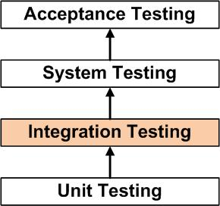

Slide 48
Groups of subsystems (collection of subsystems) and
eventually the entire system
Carried out by developers
Goal
: Test the interface among the subsystems

Slide 49
Verification
Verification is a process of evaluating the intermediary work products of a software development lifecycle to check if we are in the right track of creating the final product.

Slide 50
Verification: "Are we building the product right"
  The software should conform to its specification
Validation: "Are we building the right product"
  The software should do what the user really requires
V & V must be applied at each stage in the software process
Two principal objectives
  Discovery of defects in a system
  Assessment of whether the system is usable in an operational situation

Slide 51
Static and dynamic verification
STATIC – Software inspections
  Concerned with analysis of the static system representation to discover problems
  May be supplement by tool-based document and code analysis
DYNAMIC – Software testing
  Concerned with exercising and observing product behaviour
  The system is executed with test data and its operational behaviour is observed

Slide 52
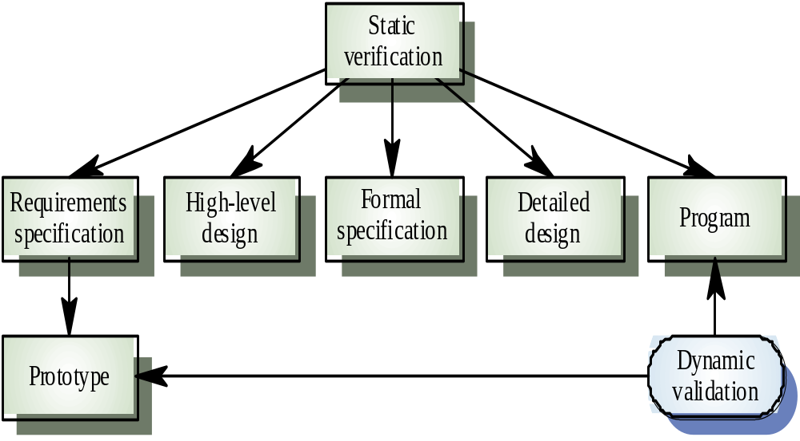

Slide 53
Program testing
Can reveal the presence of errors, not their
absence
A successful test is a test which discovers one
or more errors
The only validation technique for non-functional
requirements
Should be used in conjunction with static
verification to provide full V&V coverage

Slide 54
Types of testing
Defect testing
  Tests designed to discover system defects.
  A successful defect test is one which reveals the presence
  of defects in a system.
Statistical testing
  Tests designed to reflect the frequency of user inputs
  Used for reliability estimation

Slide 55
V & V goals
Verification and validation should establish confidence that the software is fit for purpose
This does not mean completely free of defects
Rather, it must be good enough for its intended use
  The type of use will determine the degree of confidence that is needed

Slide 56
Key points
Verification and validation are not the same thing.
  Verification shows conformance with specification
  Validation shows that the program meets the customer’s needs
Test plans should be drawn up to guide the testing process
Static verification techniques involve examination and analysis of the program for error detection
Program inspections are very effective in discovering errors

Slide 57
Static analysis tools can discover program anomalies which may be an indication of faults in the code
Program code in inspections is checked by a small team to locate software faults
The Clean room development process depends on incremental development, static verification and statistical testing

Slide 58
System Testing
SYSTEM TESTING is a level of software testing where a complete and integrated software is tested.
System Testing is the third level of software testing performed after Integration Testing and before Acceptance Testing
Normally, independent Testers perform System Testing.
System testing during development involves integrating components to create a version of the system and then testing the integrated system.
The focus in system testing is testing the interactions between components.

Slide 59
System testing checks that components are compatible, interact correctly and transfer the right data at the right time across their interfaces.
System testing tests the emergent behavior of a system
During system testing, reusable components that have been separately developed and off-the-shelf systems may be integrated with newly developed components.
The complete system is then tested.

Slide 60
Components developed by different team members or sub-teams may be integrated at this stage.
System testing is a collective rather than an individual process.
In some companies, system testing may involve separate testing team with no involvement from designers and programmers.

Slide 61
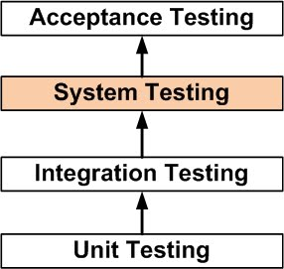

Slide 62
Integration Testing Vs System Testing
When two or more modules are combined and tested, it is called integration testing.
After all the modules are combined and the complete system is made, testing of the whole system is known as System Testing.
System Testing is testing of the software application as a whole to check if the system is complaint with the user requirements.
It is an end to end user perspective testing intended to find defects in the software system.
System Testing is a type of black box testing technique thus the knowledge of internal code in not required.

Slide 63
Two Types ..
Functional Testing
Non Functional Testing
To check whether the software system is made according to the customer needs written in Software Requirements Specifications, it meets both functional and non-functional design requirements of the system.

Slide 64
Regression Testing
In the context of an integration test strategy, regression testing is the re execution of some subset of tests that have already been conducted to ensure that changes have not propagated unintended side effects
Regression testing may be conducted manually, by re-executing a subset of all test cases or using automated capture/playback tools.
Capture/playback tools enable the software engineer to capture test cases and results for subsequent playback and comparison.

Slide 65
The regression test suite (the subset of tests to be executed) contains three different classes of test cases:
•1 A representative sample of tests that will exercise all software functions.
•2 Additional tests that focus on software functions that are likely to be affected by the change.
•3 Tests that focus on the software components that have been changed.

Slide 66
Security Testing
Security testing attempts to verify that protection mechanisms built into a system will, in fact, protect it from improper penetration.
During security testing, the tester plays the role(s) of the individual who desires to penetrate the system

Slide 67
Stress Testing
Stress testing executes a system in a manner that demands resources in abnormal quantity, frequency, or volume.
(1) special tests may be designed that generate ten interrupts per second, when one or two is the average rate,
(2) input data rates may be increased by an order of magnitude to determine how input functions will respond,
(3) test cases that require maximum memory or other resources are executed,

Slide 68
(4) test cases that may cause thrashing in a virtual operating system are designed.
(5) test cases that may cause excessive hunting for disk-resident data are created. Essentially, the tester attempts to break the program.

Slide 69
Performance Testing
Performance testing is designed to test the run-time performance of software within the context of an integrated system
Performance testing occurs throughout all steps in the testing process.
Even at the unit level, the performance of an individual module may be assessed as white-box tests are conducted.
However, it is not until all system elements are fully integrated that the true performance of a system can be ascertained.

Slide 70
Code Walkthroughs
Informal Code Analysis Technique.
A module is taken up for the review after the module has been coded, successfully compiled & all syntax errors have been eliminated.
A few members of the development team are given the code a couple of days before walkthrough meeting.
Each member selects some test cases & simulates execution of code by hand.

Slide 71
Main objective is to discover algorithmic & logical errors in the code.
The members note down their findings of the walk through & discuss those in walk through Meeting where the coder of the module is present.

Slide 72
Guidelines
The team performing code walkthrogh should not be either too big or small.
Ideally it should consist between three to seven members.
Discussions should focus on discovery of errors & avoid deliberations on how to fix the discovered errors.
In order to foster co operation & avoid feeling among engineers, managers should not attend the walk through meetings.

Slide 73
Code Inspection
Code is examined for the presence of some common programming errors.
This is in contrast to the hard simulation of code execution carried out during walkthroughs.
Usually occurs due to programmers over confidence.
Good companies maintain a checklist of errors.
These checklists helps the programmer.

Slide 74
Examples of errors.
Use of unintentional variables.
Jumps into loops.
Non terminating loops.
Incompatable assignments.
Array indices out of bounds.
Improper storage allocation & deallocation.
Mismatches between actual & formal parameter.
Use of incorrect logical operators or incorrect precedence among operators.
Improper Verification of loop variables

